Slide 1
Cloud Computing

Slide 2
Introduction to Cloud Computing
Cloud computing refers to the delivery of computing services over the internet, enabling users to store, manage, and process data in remote servers.
Key Benefits:
Cost Efficiency
Scalability
Flexibility
Accessibility

Slide 3
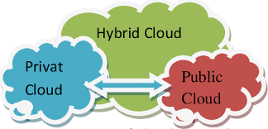
Types of Cloud
Public Cloud:
Hosted by third-party providers
Shared resources
Examples: AWS, Microsoft Azure
Private Cloud:
Exclusively used by a single organization
Greater control & security
Hybrid Cloud:
Combination of public and private clouds
Balance between flexibility & control

Slide 4
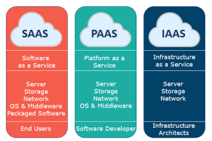
Cloud Service Models
IaaS (Infrastructure as a Service):
Provides virtualized computing resources over the internet.
Examples: AWS EC2, Google Compute Engine
PaaS (Platform as a Service):
Offers development platforms for building and deploying applications.
Examples: AWS Elastic Beanstalk, Heroku
SaaS (Software as a Service):
Delivers fully managed software applications over the internet.
Examples: Gmail, Salesforce

Slide 5
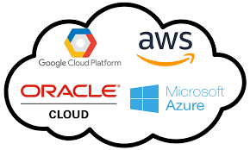
Major Cloud Providers
Amazon Web Services (AWS):
Leading cloud provider with extensive services
Microsoft Azure:
Strong integration with Microsoft products
Google Cloud:
Focus on data analytics and AI solutions
IBM Cloud, Oracle Cloud:
Enterprise-focused solutions

